Slide 1
Shortest Paths
CS340

Slide 2
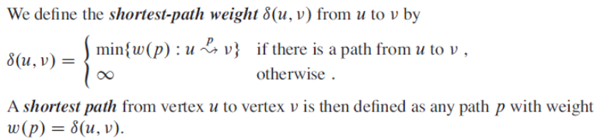
Shortest Paths
Input: Directed graph with edge weights
Weight of path p = sum of edge weights on path p
Shortest-path weight = δ(u,v)

Slide 3
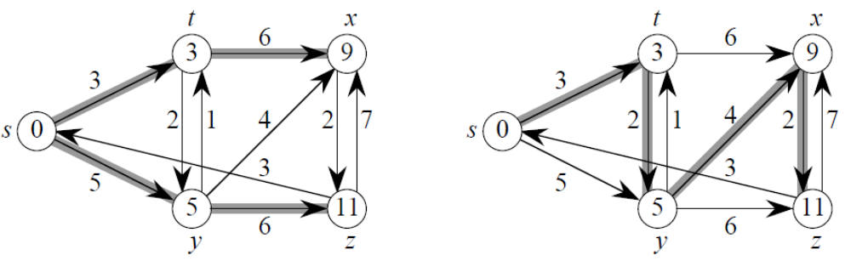
Shortest paths from s
Shortest paths might not be unique
Shortest paths form a tree

Slide 4
Variants
Single-source shortest-paths problem
Given a graph G = (V,E) we want to find a shortest path from a given source vertex to all other vertices
Single-destination shortest-paths problem
Find a shortest path to a given destination vertex t from each other vertex.
Single-pair shortest-path problem
All known algorithms for this problem have the same worst-case asymptotic running time as the best single-source algorithms.
All-pairs shortest-paths problem
Find a shortest path from u to v for every pair of vertices u and v.

Slide 5
Optimal substructure of a shortest path
A shortest path between two vertices contains other shortest paths within it.

Slide 6
Negative-weight edges
OK, as long as no negative-weight cycles are reachable from the source.
If we have a negative-weight cycle, we can just keep going around it, and get δ(s,v) = -∞ for all v on the cycle.
Some algorithms work only if there are no negative-weight edges in the graph.
We’ll be clear when they’re allowed and not allowed.

Slide 7
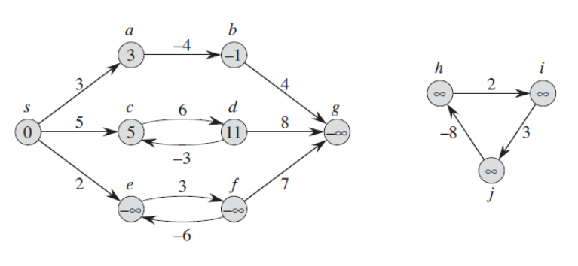
Negative-Weight Cycles
(e,f) is a negative-weight cycle reachable from s.
Notice that the distance from s to g is -infinity.

Slide 8
Cycles
Shortest paths can’t contain cycles.
Negative-weight
Already ruled out negative-weight cycles.
Positive-weight
We can get a shorter path by omitting the cycle.
Zero-weight
No reason to use them. Assume that our solutions won’t use them.

Slide 9
Output of single-source shortest-path algorithm
For each vertex v ∈ V:
v.d = δ(s, v)
Initially v.d = ∞.
Reduces as algorithms progress. But always maintain v.d ≥ shortestDistance(s,v)
While running algorithm, v.d is a shortest-path estimate.
v.π predecessor of v on a shortest path from s.
If no predecessor, v.π = NIL.
π induces a shortest-path tree.

Slide 10
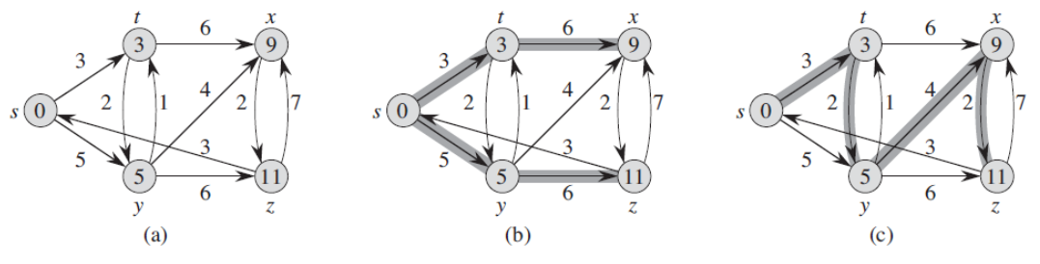
Output of single-source shortest-path algorithm
Shortest paths, and shortest path trees are not necessarily unique.

Slide 11
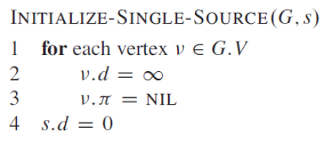
Initialization
All the shortest-paths algorithms start with INIT-SINGLE-SOURCE.

Slide 12
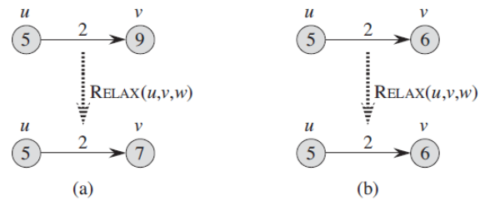
Relaxing an edge
Can we improve the shortest-path estimate for v by going through u and taking (u,v)?

Slide 13
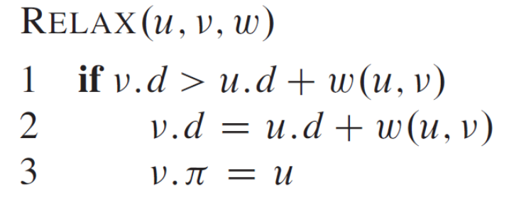
Relaxing an edge

Slide 14
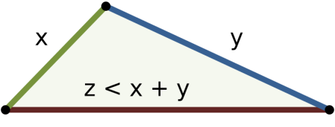
Properties of shortest paths and relaxation
Triangle inequality
Upper-bound property
We always have v.d ≥ δ(s,v) for all vertices v, and once v.d achieves the value δ(s,v) it never changes.
No-path property
If there is no path from s to v, then we always have v.d=∞.
Convergence property
If s↝u→v is a shortest path in G for some u,v ∈ V, and if u.d=δ(s,u) at any time prior to relaxing edge (u,v), then v.d=δ(s,v) at all times afterward.

Slide 15
Properties of shortest paths and relaxation
Path-relaxation property
If p = <v₀, v₁,…,v_{k}> i is a shortest path from s = v₀ to v_{k}, and we relax the edges of p in the order (v₀, v₁), (v₁,v₂),…(v_{k-1},v_{k}). then v_{k}.d = δ(s, v_{k}). This property holds regardless of any other relaxation steps that occur, even if they are intermixed with relaxations of the edges of p.
Predecessor-subgraph property
Once v.d = δ(s,v) for all v∈V, the predecessor subgraph is a shortest-paths tree rooted at s.

Slide 16

Interview Questions
What is the result of relaxing the following edges?

Slide 17
Dijkstra's Algorithm
No negative-weight edges.
Essentially a weighted version of breadth-first search.
Instead of a FIFO queue, uses a priority queue.
Keys are shortest-path weights (v.d).
Have two sets of vertices:
S = vertices whose final shortest-path weights are determined
Q = priority queue = V-S.

Slide 18
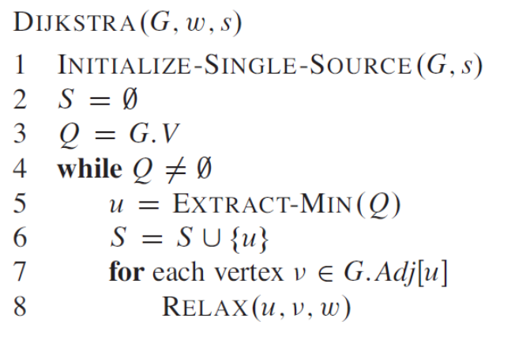
Dijkstra's Algorithm

Slide 19
Dijkstra's Algorithm
Looks a lot like Prim’s algorithm, but computing v.d, and using shortest-path weights as keys.
Dijkstra’s algorithm can be viewed as greedy, since it always chooses the “lightest” (“closest”) vertex in V-S to add to S.

Slide 20
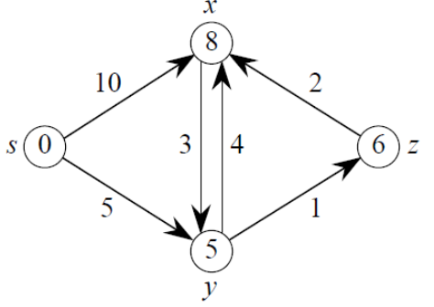
Dijkstra's Algorithm
Step | s | x | y | Z
init | s.d=0 s.π=nil | x.d=∞ x.π=nil | y.d=∞ y.π=nil | z.d=∞ z.π=nil
1 | s.d=0 s.π=nil | x.d=10 x.π=s | y.d=5 y.π=s | z.d=∞ z.π=nil
2 | s.d=0 s.π=nil | x.d=9 x.π=y | y.d=5 y.π=s | z.d=6 z.π=y
3 | s.d=0 s.π=nil | x.d=9 x.π=y | y.d=5 y.π=s | z.d=6 z.π=y
4 | s.d=0 s.π=nil | x.d=8 x.π=z | y.d=5 y.π=s | z.d=6 z.π=y

Slide 21
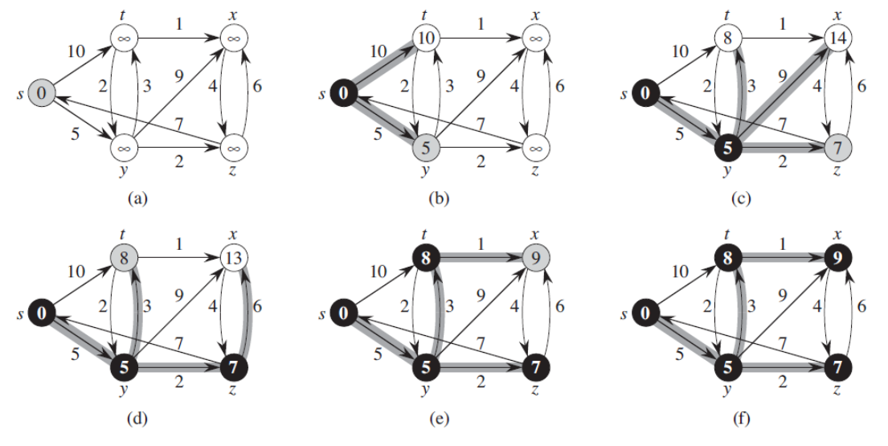
Dijkstra's Algorithm

Slide 22
Time Complexity of Dijkstra
Time complexity depends on how it is implemented
Matrix:
Each EXTRACT-MIN takes O(V) time to look through the array
There are V EXTRACT-MIN instructions for O(V²)
Priority Queue
The algorithm is only 1 line different from Prim
O(E lg V)

Slide 23
Interview Questions
Suppose we change Dijkstra’s algorithm such that the last vertex is not removed from the priority queue, and the while loop to executes |V|-1 times instead of |V| times. Is this proposed algorithm correct?
To implement Dijkstra’s shortest path algorithm on unweighted graphs so that it runs in linear time, what data structure can be used?
In a weighted graph, assume that the shortest path from a source s to a destination t is correctly calculated using Dijkstra's algorithm. Is the following statement true? If we increase weight of every edge by 1, the shortest path always remains the same.

Slide 24
Interview Questions
Given a graph, suppose we have calculated shortest path from a source to all other vertices. If we modify the graph such that the weights of all edges are doubled, does the shortest path remain the same?
Given a weighted graph where weights of all edges are unique (no two edges have same weights), is there always a unique shortest path from a source to destination in such a graph?
Each edge in a connected, unweighted graph G is colored either red or blue. Present an algorithm to compute a path between s and t that traverses the fewest number of red edges. Analyze its running time.

Slide 25
Bellman-Ford Algorithm
Allows negative-weight edges.
Computes v.d and π.d for all v ∈ V.
Returns TRUE if no negative-weight cycles reachable from s, FALSE otherwise.

Slide 26
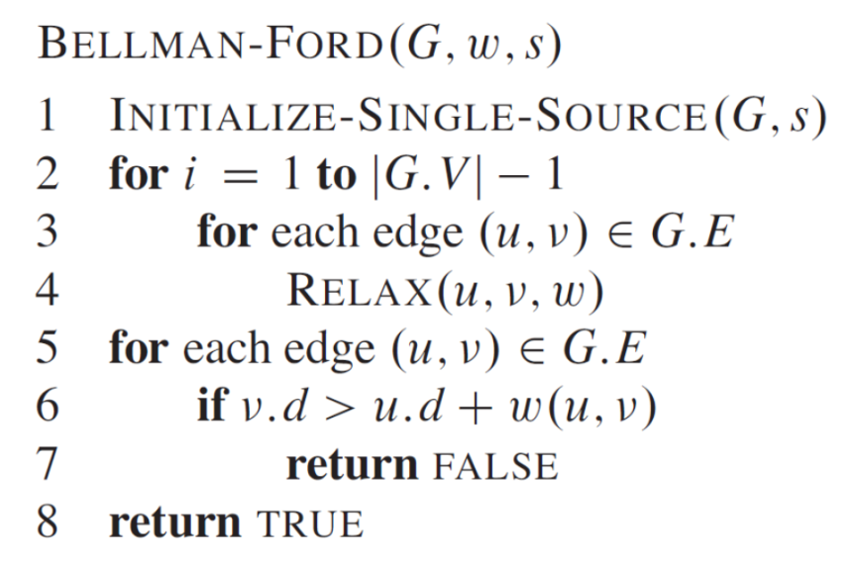
Bellman-Ford Algorithm
Relies on the Path Relaxation Property
Relaxes each edge |V|-1 times (why?)
Relaxes each edge 1 more time to detect negative-weight cycles. Returns true if none.
Time Complexity: nested for loop outer loop = |v|-1 inner loop = E Total = Θ(VE)

Slide 27
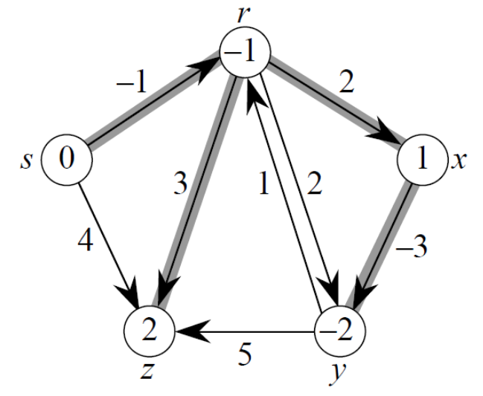
Bellman-Ford

Slide 28
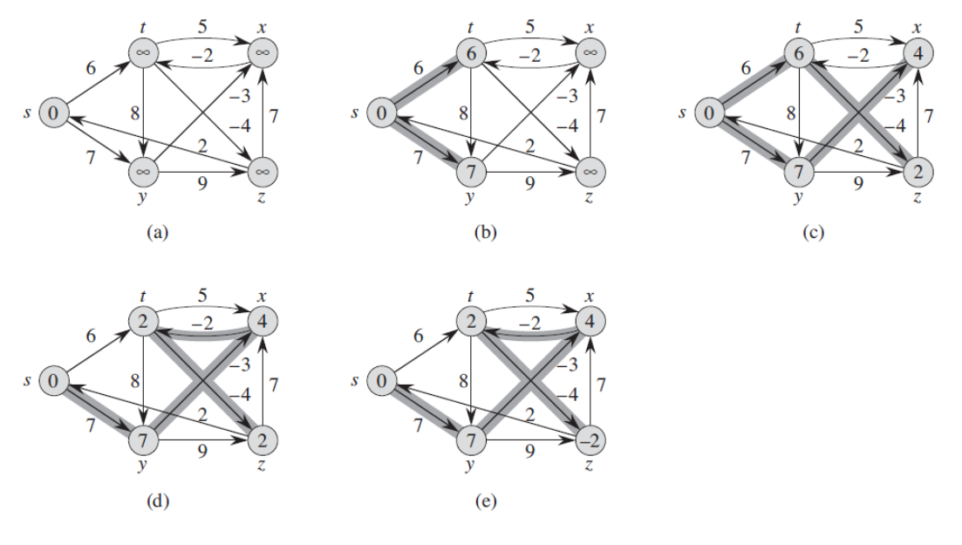
Bellman-Ford
Edges relaxed in this order:
(t,x) (t,y) (t,z) (x,t) (y,x) (y,z) (z,x) (z,s) (s,t) (s,y)

Slide 29
Interview Questions
What is the time complexity of Bellman-Ford on a complete graph of n vertices?
After the i^{th} relaxation of every edge, which paths have converged to the correct value where v.d = δ(s,v)?
Given a graph G = (V, E) with positive edge weights, can the Bellman-Ford algorithm and Dijkstra’s algorithm produce different shortest-path trees? Will they always produce the same shortest-path weights?
What does it mean if a sequence of relaxation steps sets the source vertex s to a non-NIL value?

Slide 30
Interview Questions
Suppose that you want to get from vertex s to vertex t but you would like to stop by vertex u if it is possible to do so without increasing the length of your path by more than a factor of α. Describe an efficient algorithm that would determine an optimal s-t path given your preference for stopping at u along the way if doing so is not prohibitively costly. (It should either return the shortest path from s to t or the shortest path from s to t containing u, depending on the situation.)

Slide 31
Single-source shortest paths in a dag
Dag = Directed Acyclic Graph
We’re guaranteed no negative-weight cycles
Negative-weight edges are ok
Relax edges according to a topological sort of vertices
By the Path Relaxation Property, relaxing in topological order guarantees edges are relaxed in path order.

Slide 32
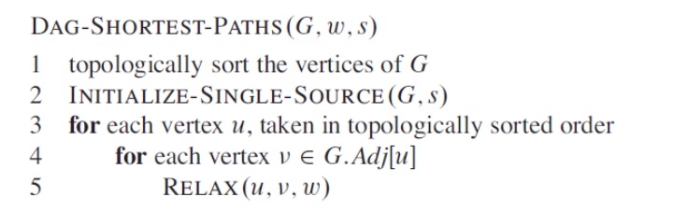
Single-source shortest paths in a dag
Time complexity Θ(V+E)

Slide 33
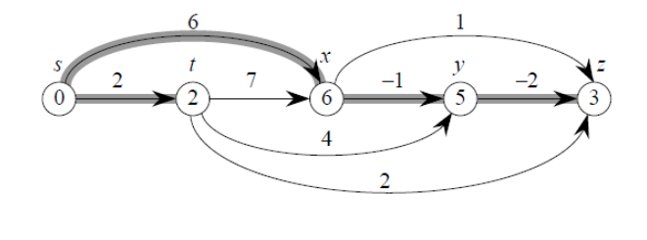
Single-source shortest paths in a dag

Slide 34
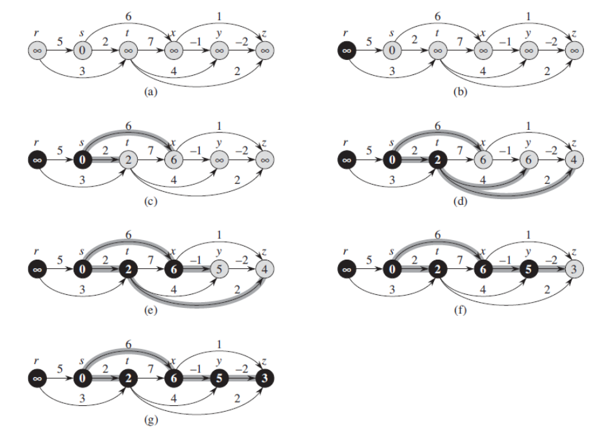
Single-source shortest paths in a dag

Slide 35
Interview Questions
Suppose we change DAG-SHORTEST-PATHS to process only the first |V|-1 vertices, taken in topologically sorted order. Would the algorithm remain correct?
Can a directed acyclic graph have more than one topological ordering?
Give a Θ(V+E) algorithm for finding the longest paths from s in a weighted directed acyclic graph G. Does your solution work when G is not acyclic?

Slide 36
All-Pairs shortest paths
As opposed to single source, we want to find distances between all pairs of vertices.
Output: A matrix of shortest path distances
Could run BELLMAN-FORD once from each vertex
O(V²E) which is O(V⁴) if the graph is dense (E = Θ(V²)).
If no negative-weight edges, could run Dijkstra’s algorithm once from each vertex
O(VE lg V) with binary heap → O(V³ lg V) if dense,
O(V² lg V + VE) with Fibonacci heap → O(V³) if dense.

Slide 37
Floyd-Warshall algorithm
A completely different approach
Negative-weight edges may be present
No negative-weight cycles

Slide 38
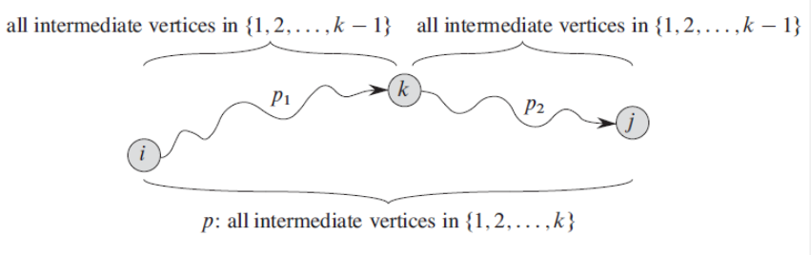
Floyd-Warshall algorithm
Looking for a path from i to j, does it pass through vertex k?
Use a matrix to iterate through every possibility.
How many possibilities are there?

Slide 39
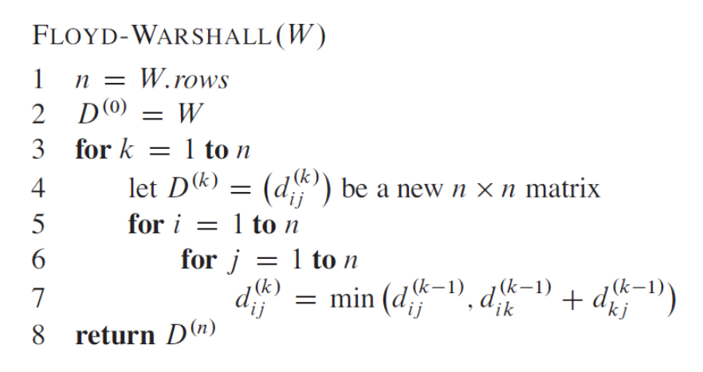
Floyd-Warshall algorithm
What is the time complexity?

Slide 40
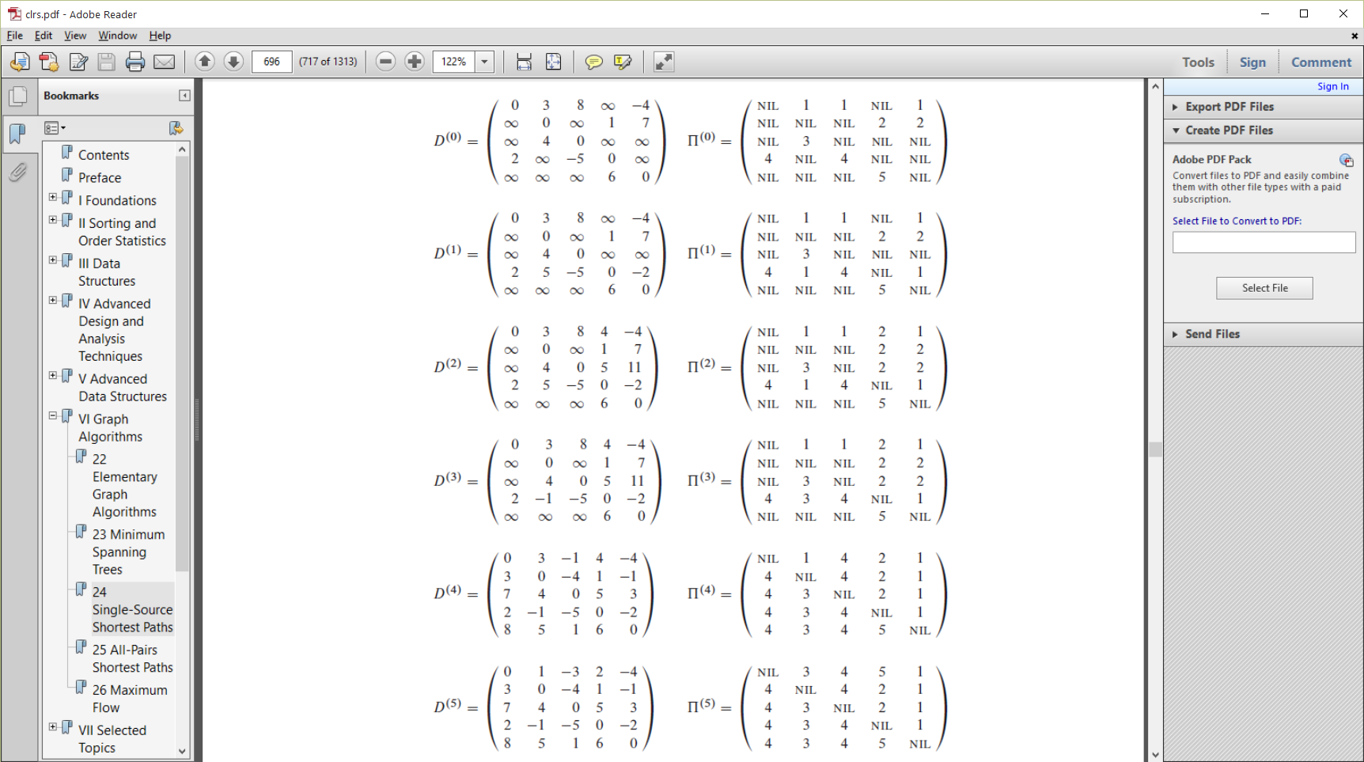
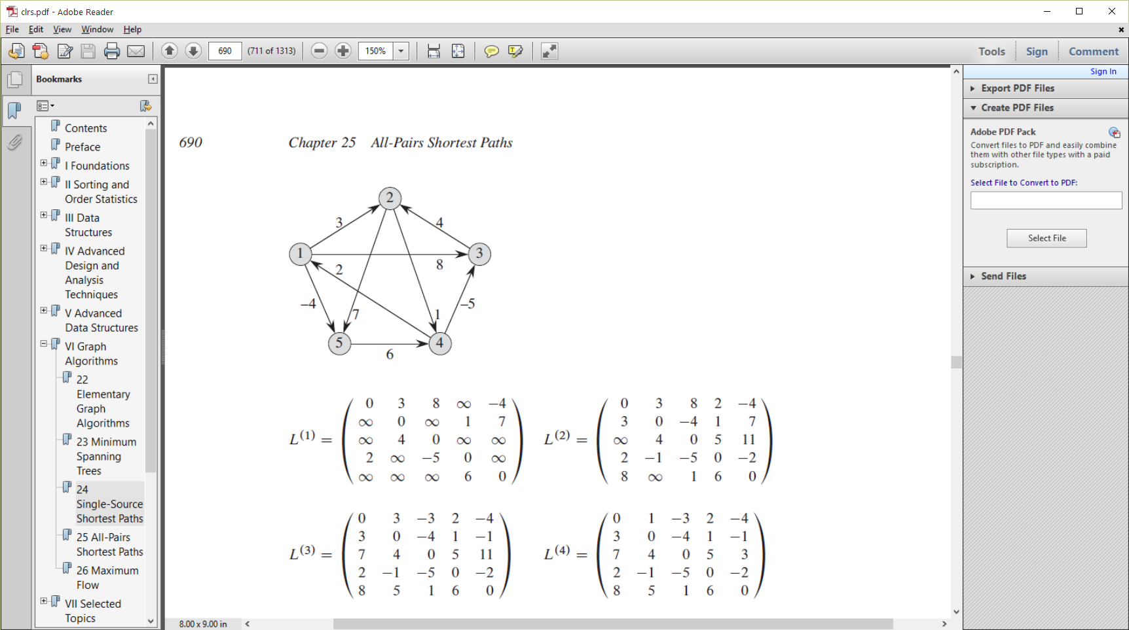
Floyd- Warshall

Slide 41
Floyd- Warshall

Slide 42
Interview Questions
How can we use the output of the Floyd-Warshall algorithm to detect the presence of a negative-weight cycle?

